Slide 1
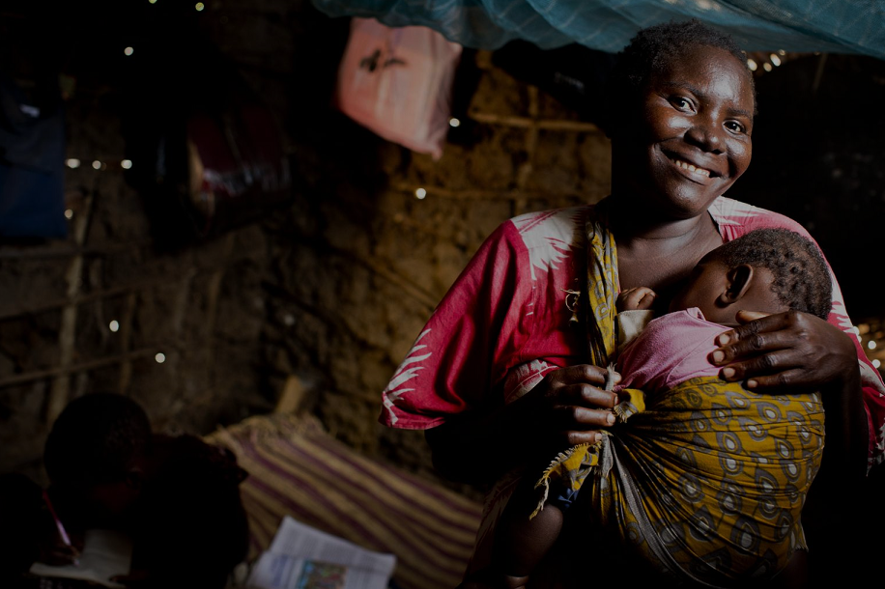
"Regional experiences implementing Community Health Worker Programs & their impact in advancing the Health Promotion Agenda”
Maureen Momanyi-Adudans
Regional Community & Child Health Specialist
Community Health Champion!
Notes:
Good morning and thank you for the warm welcome
Upcoming Word Health Summit

Slide 2
Outstanding issues
Notes:
…

Slide 3
400
Million
lack access to essential health care
Care is fragmented
… and of poor quality
Responsiveness
of the health system and satisfaction with health services remain low
Notes:
Despite significant advances in people’s health and life expectancy in recent years, relative improvements have been unequal among and within countries, particularly in our region.
400 million people globally still lack access to essential health care.
Yet where care is accessible it is too often fragmented and of poor quality, consequently responsiveness of the health system and satisfaction with the health services remain low.

Slide 4
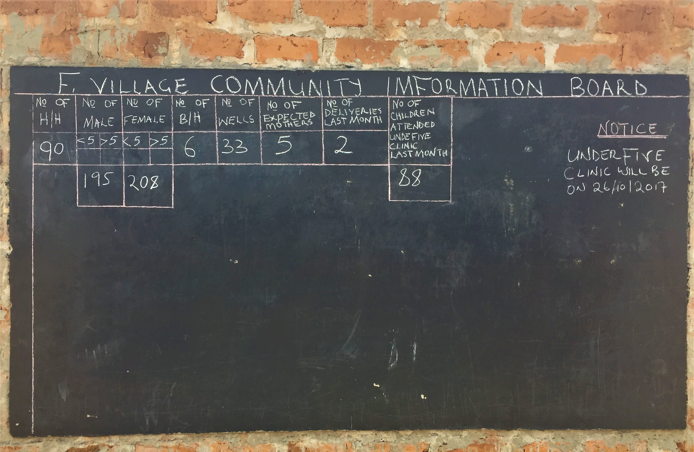
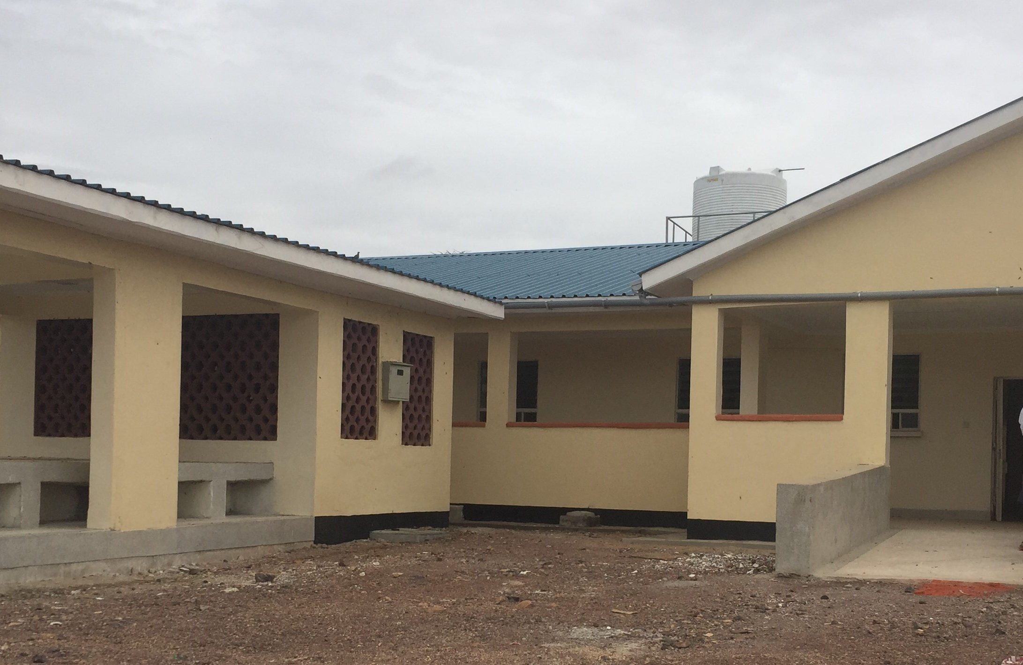
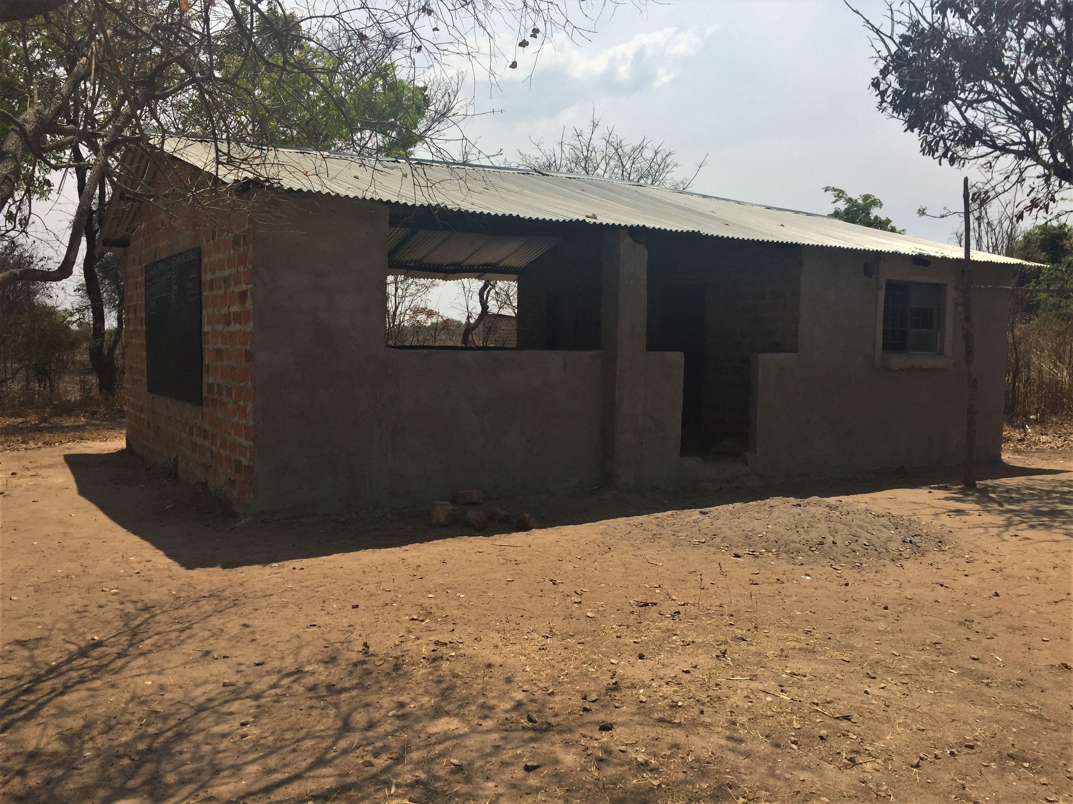
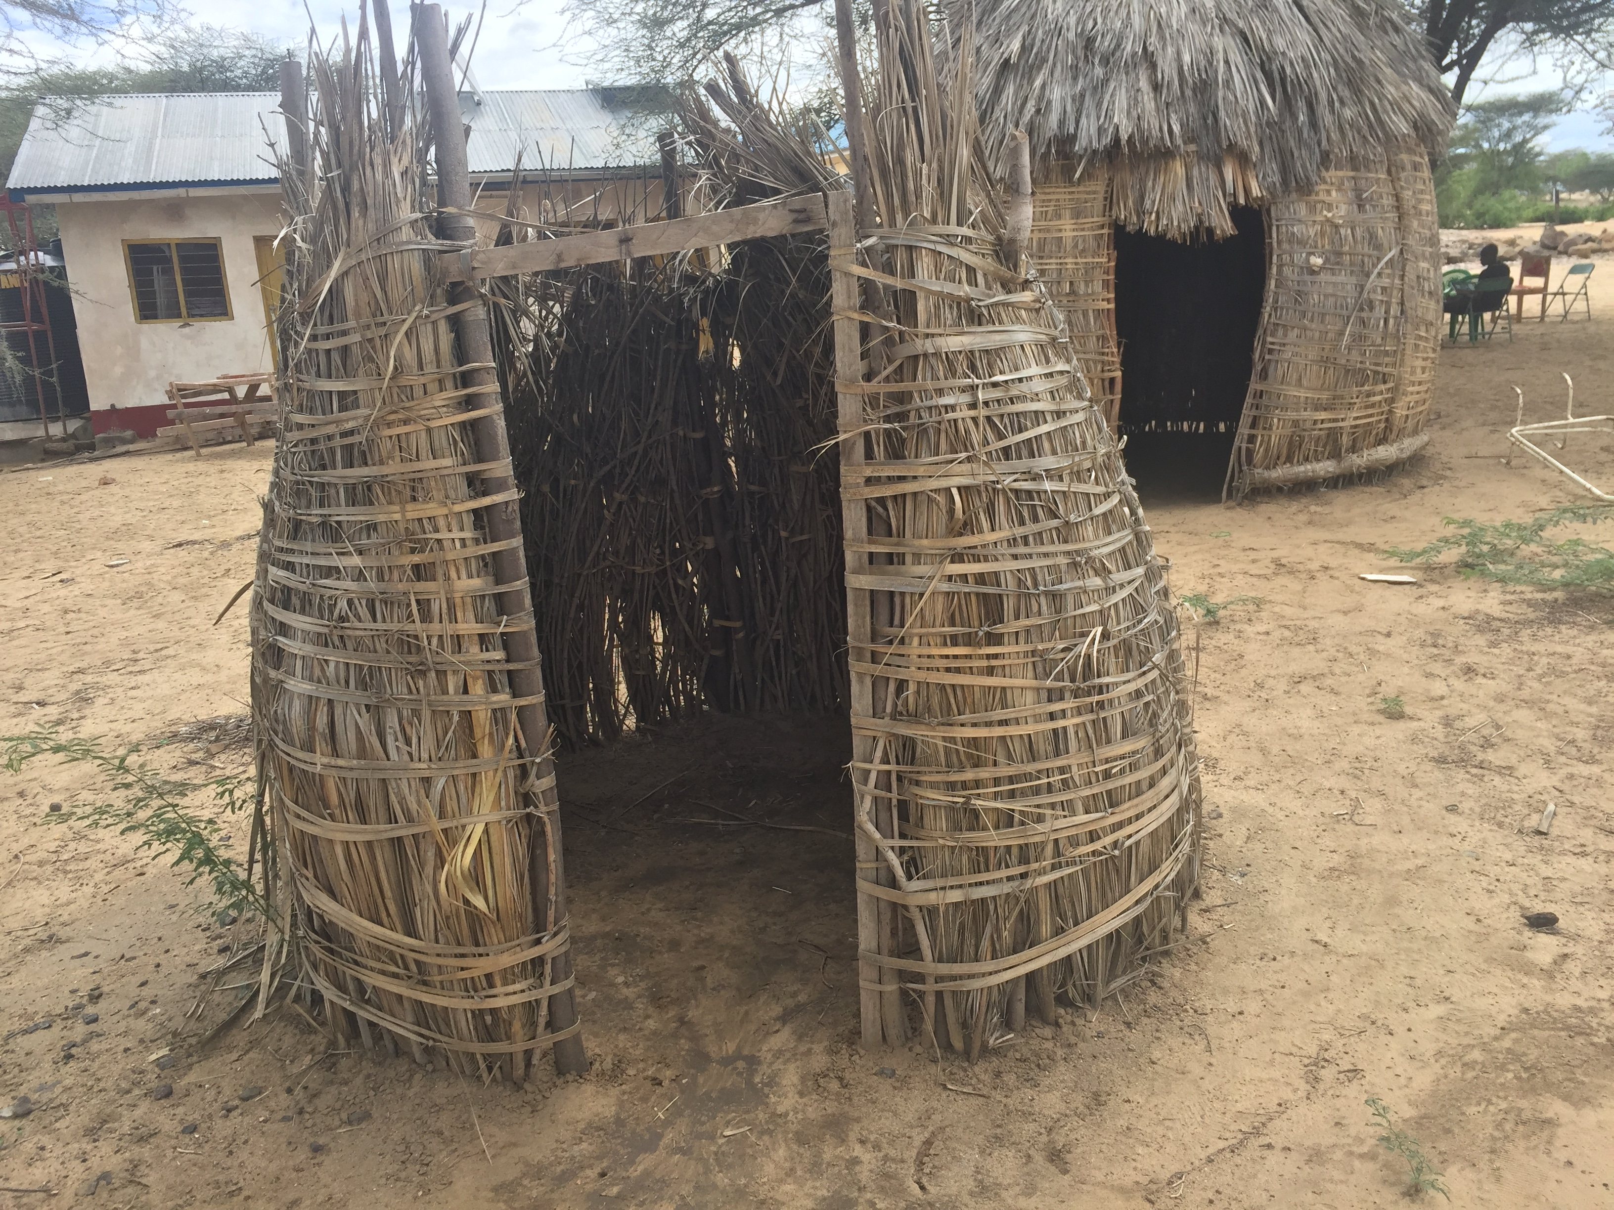
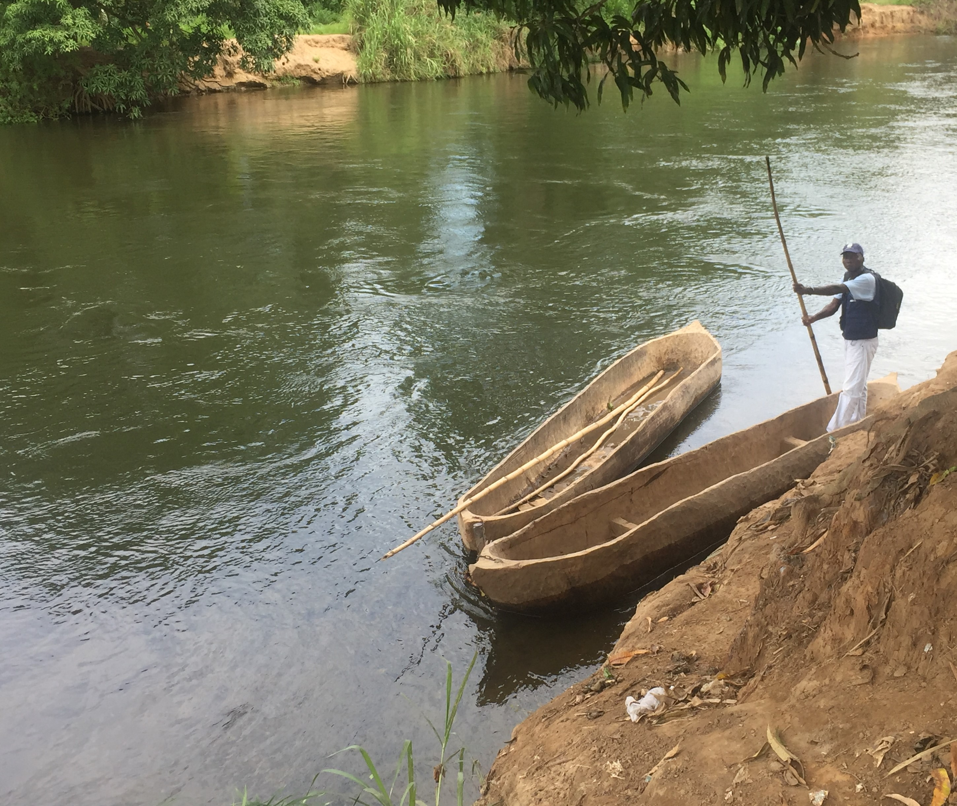
Notes:
We know that many countries are grappling with persisting challenges of unequal geographical access to health services (ADECOS is Icolo Bengo in Angola)
Shortage of health workers (and weak supply chains) health facility in Turkana County
Weak accountability systems (community information board in Zambia)
Continuity of care is poor due to weak referral systems and growing costs of secondary and tertiary care (Maternity waiting shelters in Turkana)
Underfunded, non flexible PHC systems (community – resourced health post in Zambia)
.. Verticalization of programmes and services which not only tend to be hospital based but also disease-based further serve to weaken health systems

Slide 5
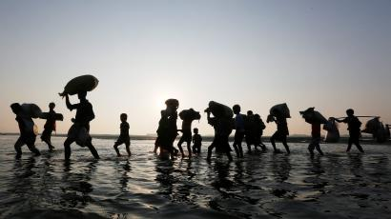
Persisting challenges
We live, work and play in a constantly changing environment
Notes:
In addition we work and live in a constantly changing environment and we are increasingly facing threats…
such as climate change, migration, urbanization and conflict that impact health outcomes directly and/or indirectly. The growing trend towards unhealthy lifestyles contributing to the dual disease burden of communicable and noncommunicable diseases, compounded by disease outbreaks and multi-morbidities only serve to increase the burden on already stretched health systems, contributing to the increasing rise in health costs

Slide 6
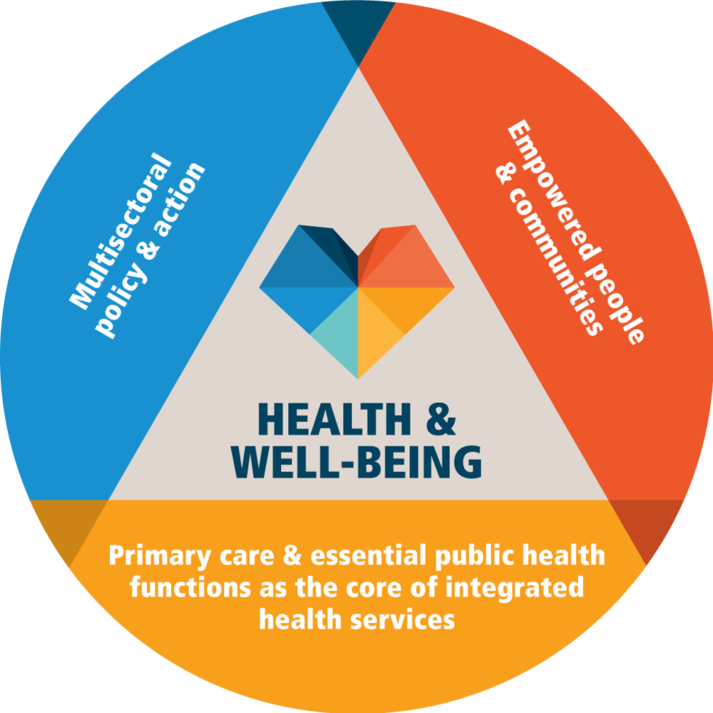
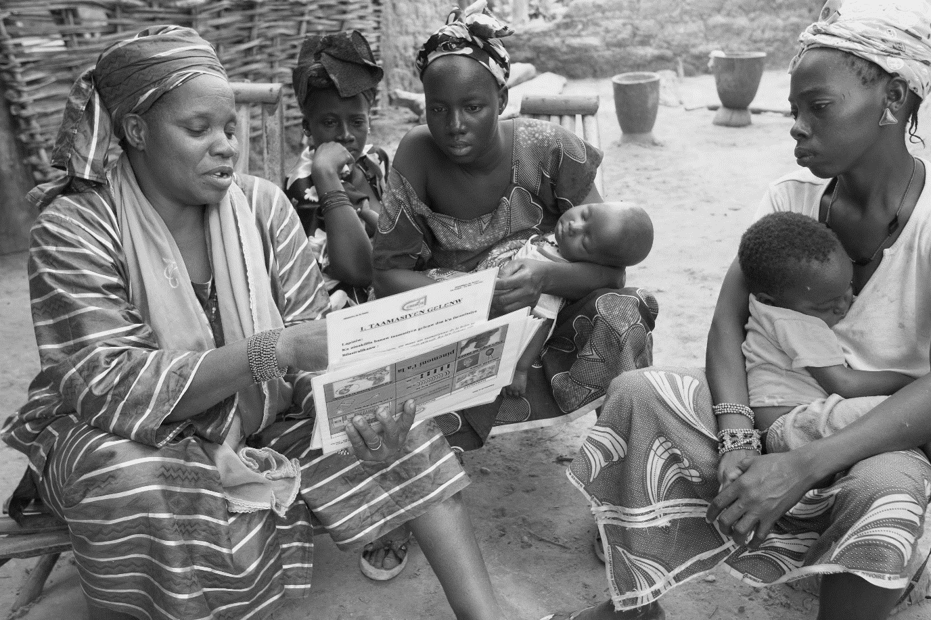
UNIVERSAL HEALTH COVERAGE
COMMUNITY
HEALTH
Notes:
In order to ensure healthy lives and promote wellbeing for all ages …
and achieve Universal Health Coverage, including equity, quality, and financial risk protection in access to health care…
We need Primary Health Care, which is the most effective, efficient, and equitable approach to enhance health…
and community health systems are foundational to delivering primary health care as they are a proven, cost-effective, and high-impact platform for delivering integrated health and social services as well as empowering communities as agents of their own health.

Slide 7
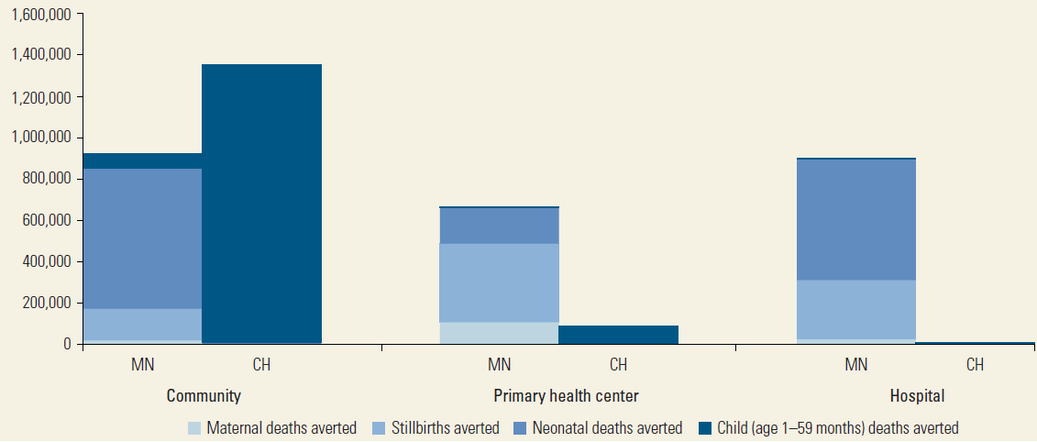
SOURCE: Black RE, Walker N, Laxminarayan R, Temmerman M. Chapter 1: Reproductive, Maternal, Newborn, and Child Health: Key Messages of this Volume. DCP3 RMNCH 2016. https://openknowledge.worldbank.org/bitstream/handle/10986/23833/9781464803482.pdf?sequence=3&isAllowed=y
Notes:
The evidence does concur with fact that community platforms are impactful.
Looking at this graph we can see that the largest impact (93 percent of avertable child deaths) can be realized by interventions in the community platform (as compared to the PHC and hospital platforms).
And health prevention and promotion interventions provided by CHWs such as promotion of breastfeeding (50K deaths), handwashing with soap, promotion of immunization, ITN use are critical contributors to the deaths averted.
But this impact can only be achieved if the community platforms are optimized

Slide 8
Notes:
To respond to the question on how well the community platforms are functioning in our region in delivering health promotion and prevention interventions let us sample some key outcome indicators (based on the most recent of three year survey data)
At least 50% of children under five living in two thirds (14 of 19) of the countries in our region who have fever are seeking care
Having said this there are a few countries that are showing negative trends or plateauing of progress

Slide 9
Notes:
The situation is not too positive for children under five sleeping under ITNs
7 of the 14 illustrative countries where we have data for the 3 past years, in the last survey year have less than 50% of the children under fie are sleeping under ITNs
And half of these countries are showing either a negative or stagnated trend in performance for this indicator

Slide 10
Notes:
Despite the fact pneumonia is one of the major killers of under 5 children in the region only slightly more than half of the countries have children who show symptoms of ARI seeking care

Slide 11
Emerging lessons
Notes:
From the data we can surmise that yes there are gains that have been made but we stand at a time point where these gains are either stagnating or in some cases we are back tracking
And some of the countries with longstanding national CH programmes are reaching this realization and re-evaluating their programmes with the aim of optimizing them, and it is from some of these that I wish to share some reflections on emerging lessons

Slide 12
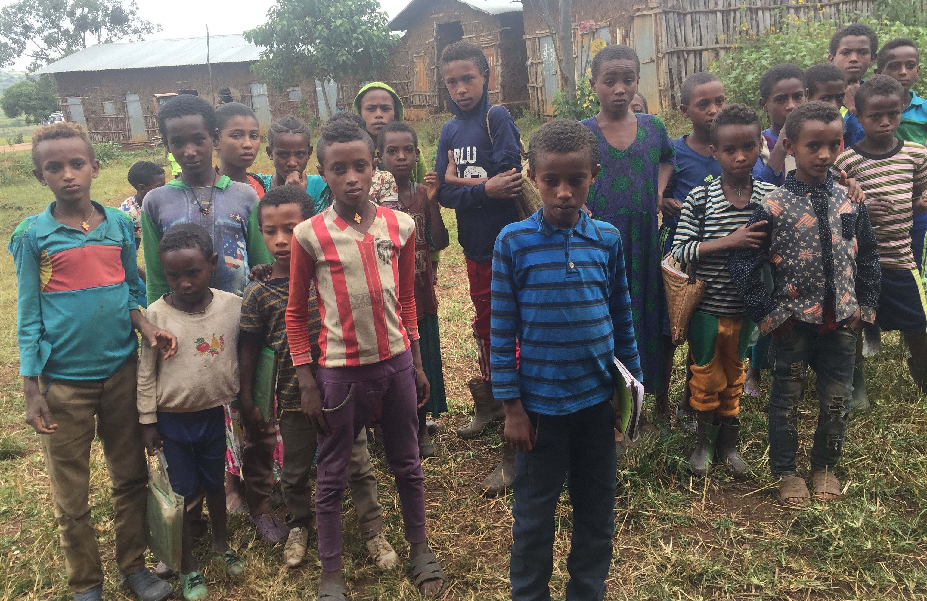
Ethiopia’s Health Extension Programme
40K
Health Extension Workers
17K
Health Posts
18
Service Packages
Notes:
Let us start our short journey round the region in Ehtiopia
HEP has been a major strategy in the provision of PHC since 2004
Started in agrarian settings with 16 packages
Subsequently customized for pastoralist and urban settings
Packages expanded with few additional clinical services
Current status
18 packages
~ 40 k HEWs
~17 k HPs
Mixed thoughts about the current status of HEP
Administrative reports were the only source of information about several aspects of HEP
The services provided under second generation HEP by level 4 HEWs include:
Disease Prevention and Control: (HIV/AIDS prevention and control, TB prevention and control, malaria prevention and control, Neglected Tropical diseases prevention and control, and NCDs prevention.
Family health services: (maternal and child health, family planning, immunization, adolescent reproductive health, and nutrition).
Hygiene and Environmental Sanitation: (proper and safe excreta disposal system, proper and safe solid and liquid waste management, water supply safety measures, food hygiene and safety measures, healthy home environment, arthropods and rodent control, institutional hygiene, and personal hygiene).
Health Education and Communication :(cross cutting).

Slide 13
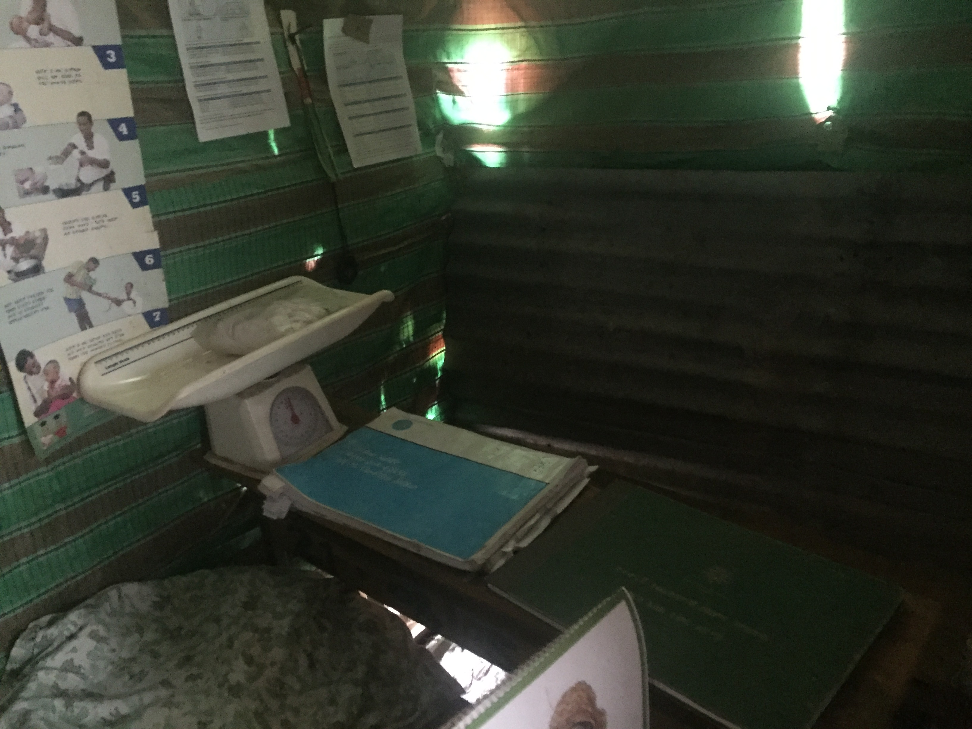
Expanded service packages
Comprehensive service packages increase acceptability & uptake
Communicable
+
Non communicable
‘…Quality of care must remain paramount…’

Slide 14
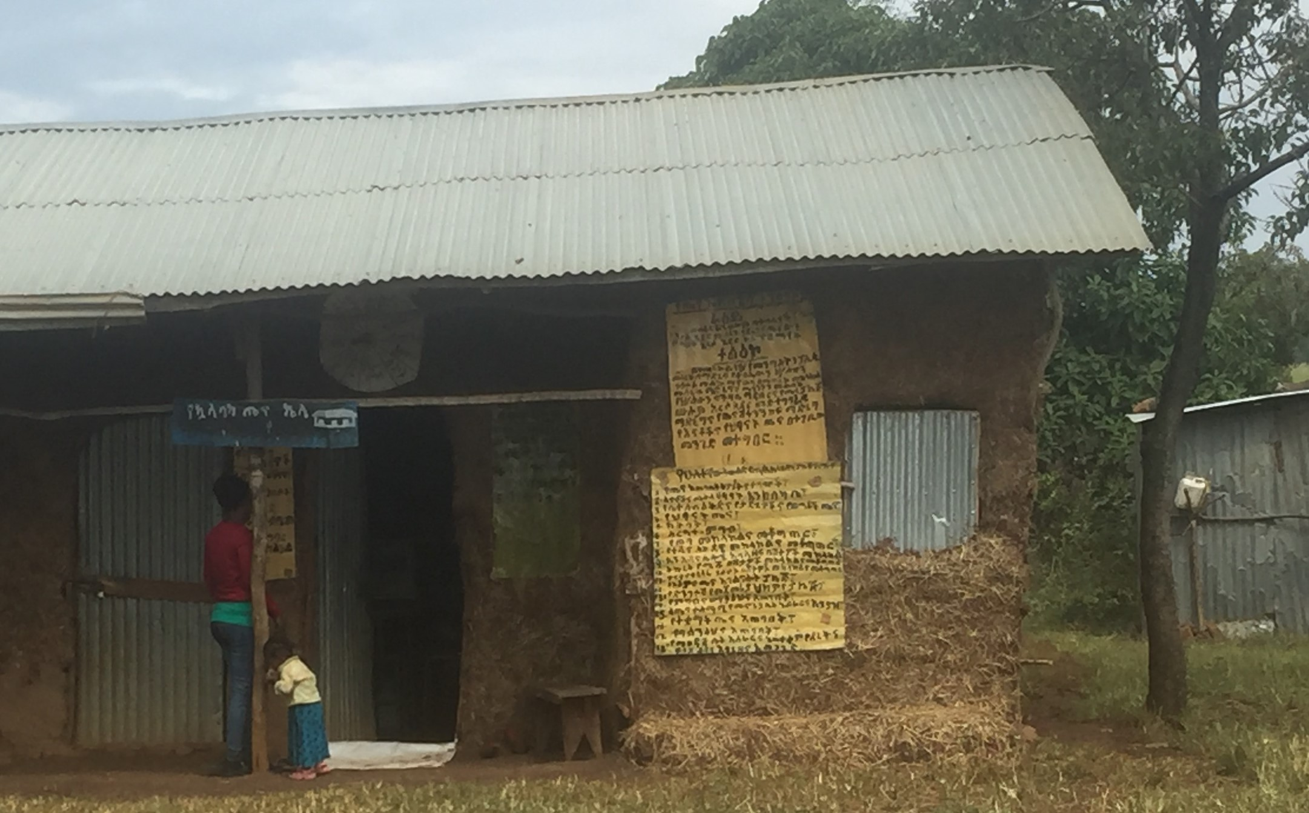
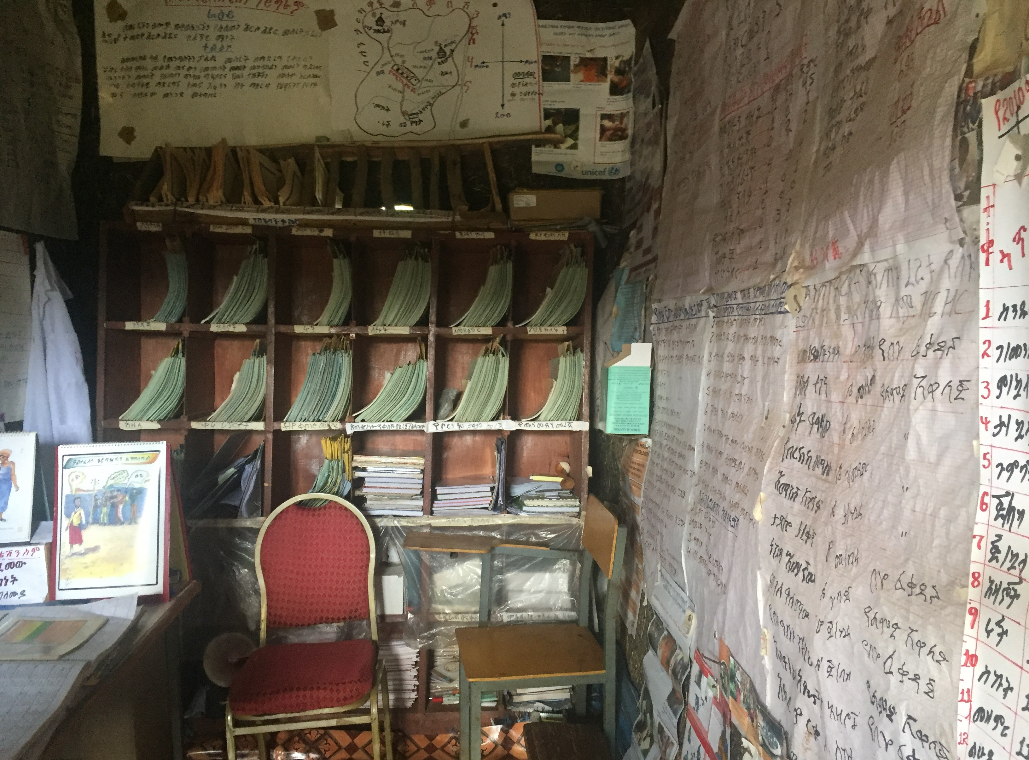
Service delivery modalities
+ Health posts, HH visits, outreach
+ Gender dynamics
+ In-country contextualization
+ Inter-sectoral collaboration
( - Campaign-based approaches)
‘…HPs are physically accessible; however, HP accessibility did not translate into actual access to services…’
Notes:
Static (health post visits as entry point for health promotion and disease prevention services), home visit, and outreach service delivery modalities are still relevant
Gender dynamics: Female HEWs responsible for contacting women during home visits + Involving male HEWs will address implementation challenges reaching men, geographical challenges, violence against female HEWs, service interruption during maternity leave
Revise behavior change theories and strategies in a way that consider variabilities in the needs of specific outcomes and cultural contexts.
Increase involvement of men and youth as targets of HEP
The strategy for outreach modality should be designed in a way that includes social capital or indigenous social institutions.
Redesign pastoralist HEP by conducting more detailed analyses of experiences in addressing health and other social needs of pastoralist communities including villagization/settlement of mobile communities, mobile health team, mapping movements of pastoralist communities, and other program specific experiences.
Strengthen inter-sectoral collaboration to ensure that strategies to implement HEP in pastoralist communities are integrated/coordinated with other community-based services including villagization and animal health services.
Word of caution
Campaign-based approach to influence behaviors that need continuous communication
Punishment or threatening as a strategy to change behavior of households
97.4% of kebeles have at least one HP
Majority of households are located within 30 minutes walking distance from HP
But having health posts that are physically accessible does not translate into actual access to services

Slide 15
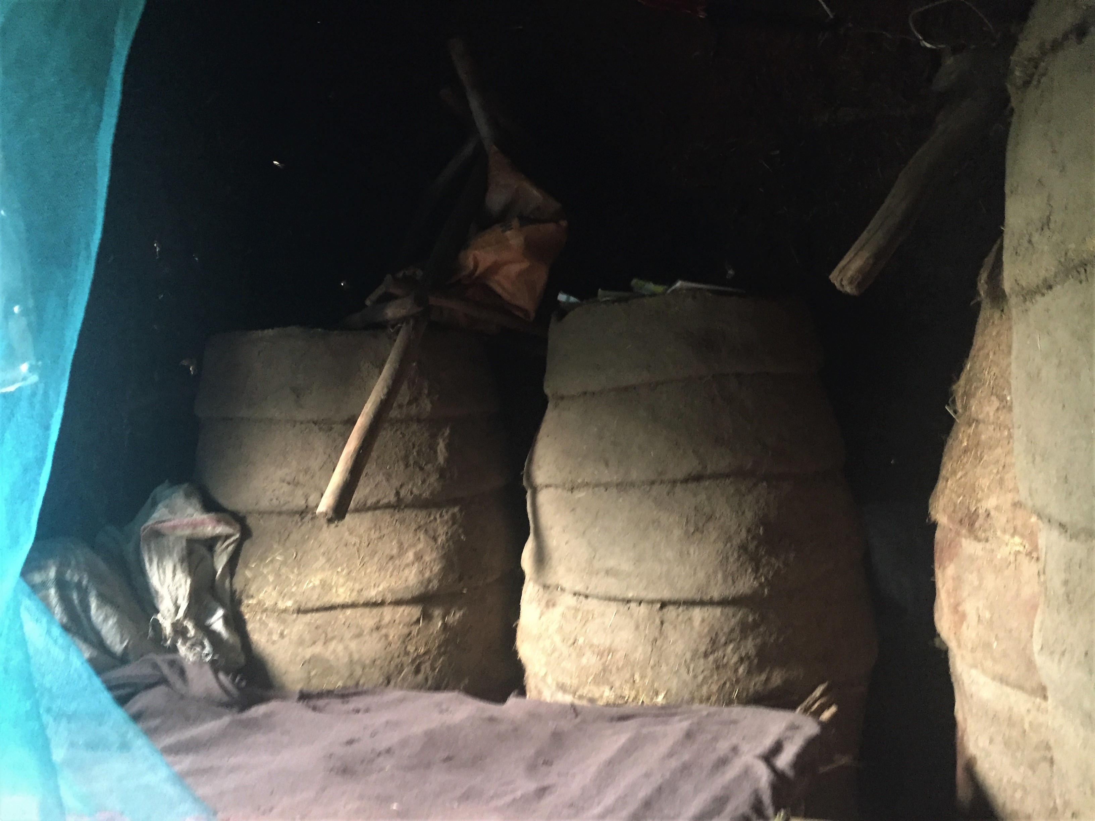
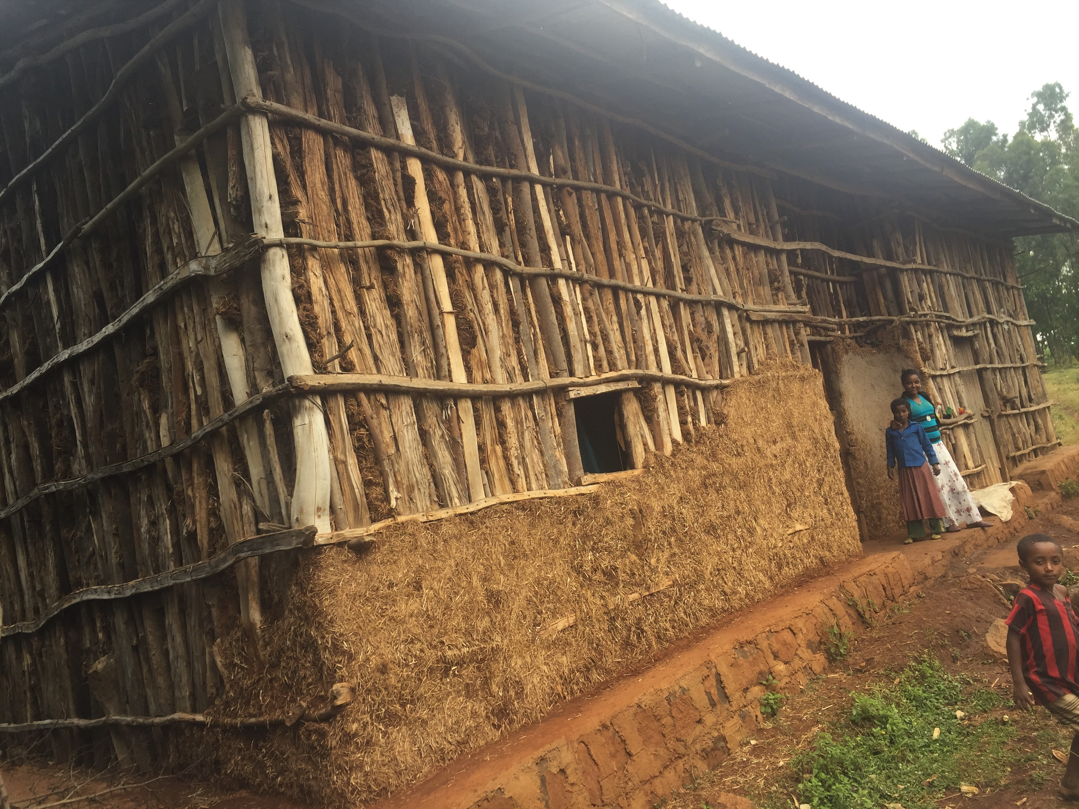
Community engagement
+ Model families
+ Selection criteria for CHWs
+ Map & engage diverse community structures and platforms
‘…Community engagement is core to the Health Extension Programme…’
Notes:
Adoption of desired household behavior increases with increasing exposure to model family training: Awareness, Enrollment and Completion
Most women who completed model family training played different roles in teaching other communities including demonstration of behavior for other women in their villages.
WDA leaders are not Models in their health behavior
Model family training is an effective strategy to increase HH level implementation of HEP. However, awareness, enrollment, and completion have low coverage.
WDA and/or SMC structures are widely available. Their functionality in supporting HEP is however very limited.
WDA leaders and SMC members are not models in their health behaviors. Selection of WDA leaders gives very little attention to health behavior.
WDA leaders currently have low acceptance and are mostly considered as political agents.
The use of WDAs alone has resulted in underutilization of community potentials including that of men, religious leaders, and traditional leaders.
Roles and responsibilities of WDA leaders sometimes overestimates their capacity and ignores the fact that these leaders are volunteers.
Involve youth, women, men, traditional leaders, religious leaders, and other influential individuals.
Use fewer (manageable size) community volunteers to serve as change agents and community mobilizers
Keep community volunteers accountable to HEWs.
There can never be a single approach to community participation

Slide 16
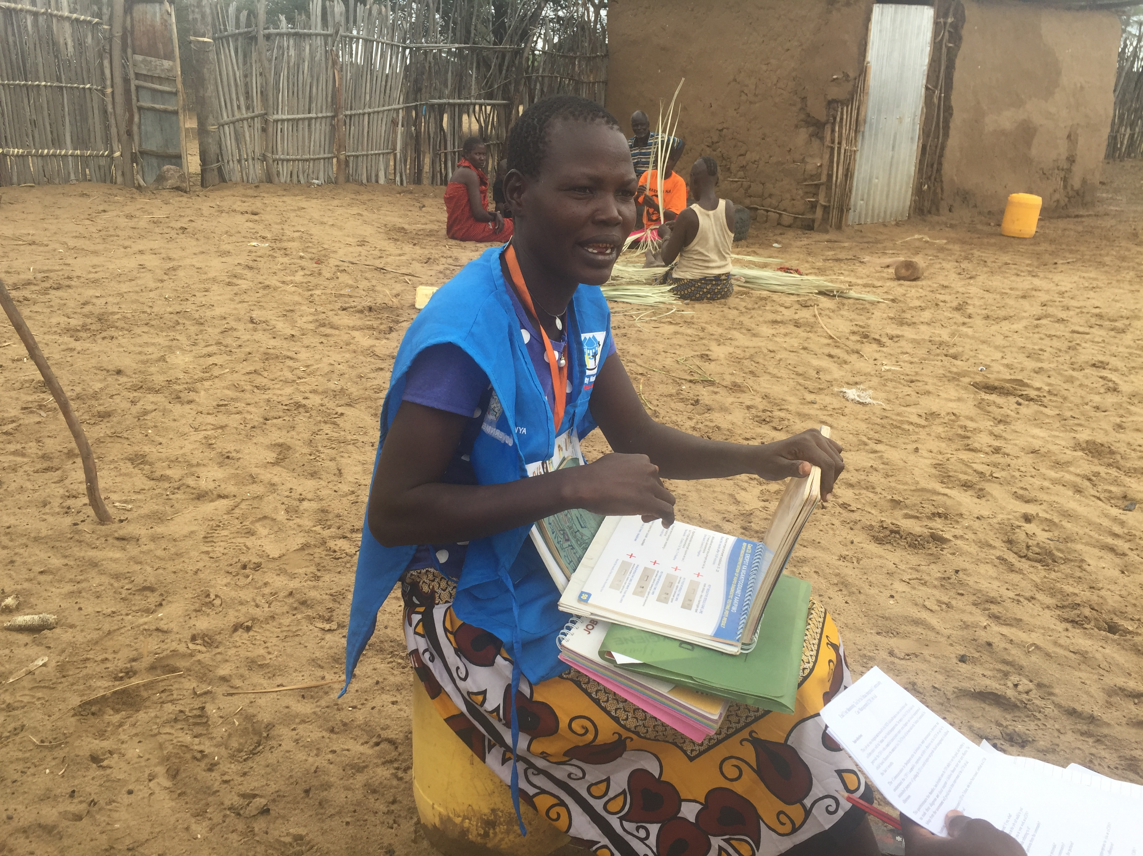
Kenya’s Community Health Strategy
60K
Community Health Volunteers
5.9K
Community Units
2K
Community Health Extension Workers
Notes:
Kenyan Community Health Stratgey was launched in 2006 as a means to deliver the Kenya Essential Package for Health defined in the second strategic plan
The 2006 strategy was revised in 2014, the revision process incorporated the devolution of health services to the counties.
Under the revised strategy (2014 - 2019), counties are responsible for delivering health services and implementing health programmes including community health
Currently there are 60,000 CHVs against the 100K anticipated, close to 6000 community units against the 10K anticipated and 2K CHEWs which falls far short of the anticipated 21K
A recently completed evaluation of the implementation of the CHS in the context of the devolved government brings to fore some important lessons for our consideration

Slide 17
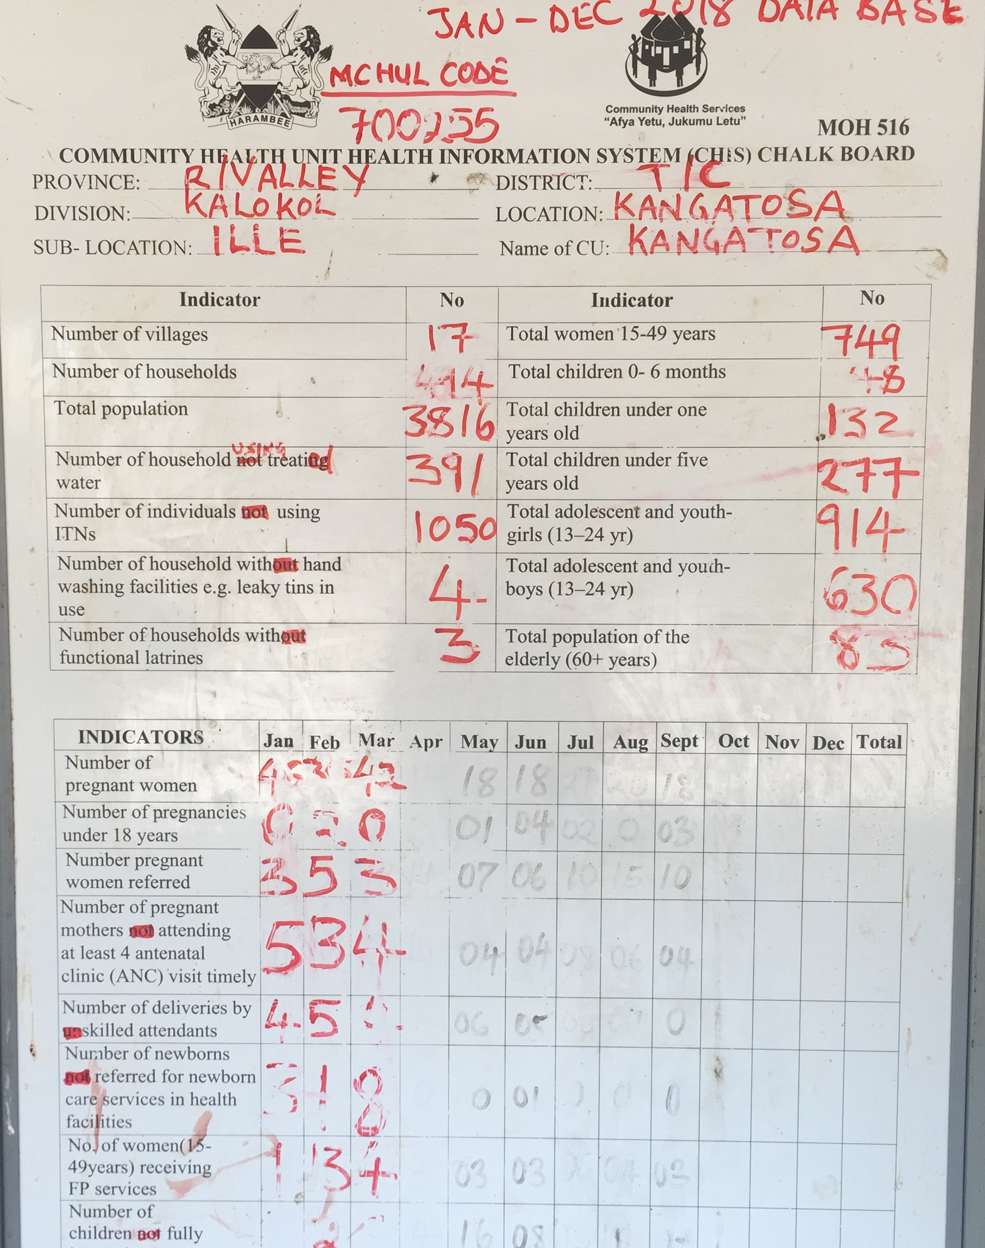
Local governance & accountability
+ Legislative framework
+ Community Health Committees
+ Dissemination of policies and strategies
Notes:
Ministry of health needs to disseminate the various polices and strategies related to community health services to all counties. This includes the scheme of service to all counties
In the context of decentralization and in particular in Kenya’s case where its extreme form of is in play that is devolution, there is need to advocate for the uptake/implementation of the NCHS but also enhance the capacities of local governance and accountability structures…
In Kenya despite having bottom-up planning and budgeting process in place this did not immediately translate into the allocation of funds for CH particularly for CH incentives, hence the need to push for legislative frameworks (that make it imperative for the county government to allocate specific financial resources towards community health services) and as a result there are a number of counties that have bills at various stages of development
The community health committee is CHC is recognized as the principle governance structure although its functionality and motivation are overlooked. CHCs roles are of a strong and functional community health system. Their functions of governance and oversight should be observed and maintained during the implementation of all community health services including health campaigns and dialogues.
Community participation is key in improving positive health seeking behavior change and subsequently health indicators. Stakeholders’ engagement through existing structures provides critical platforms for coordination of community health services

Slide 18
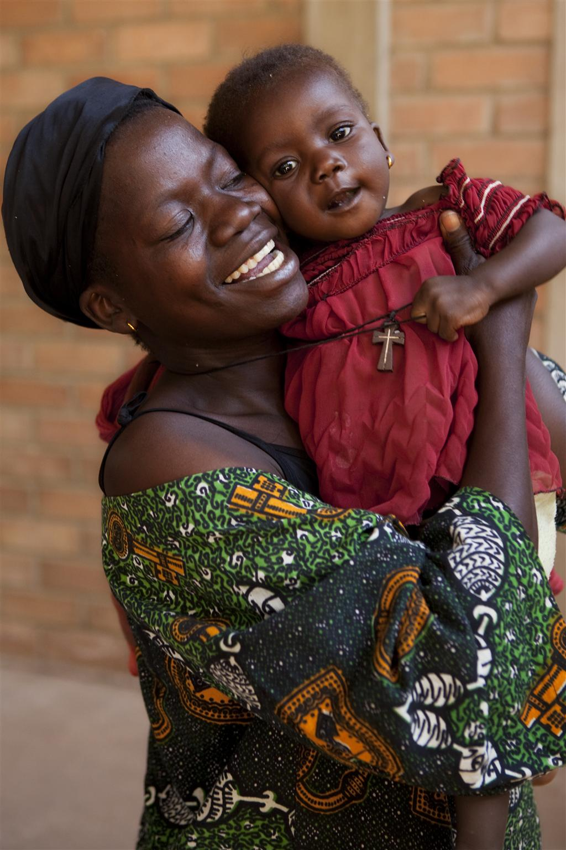
Rwanda’s Community Health Worker Reform
45K
Community Health Workers
475
CHW Cooperatives
‘…in Rwanda, a combination of community based health insurance, community health workers, and good external partnerships together led to the steepest reductions in child and maternal mortality ever recorded…’
H.E. Paul Kagame
Notes:
Started in 1995 with an initial number of 12000 CHWs with the focus on health education and facilitation of health comapigns with time their role evolved into a more comprehensive community-led initiative
They are now at 45K, with each village meant to have 3 CHWs – one called the Assistante Maternelle de Sante (ASM) in charge of MNH and oversees the Binome (male and female CHWs – polyvalent health agents)
Despite the commendable gains, sustainability of the program remains a key challenge that Rwanda must overcome

Slide 19
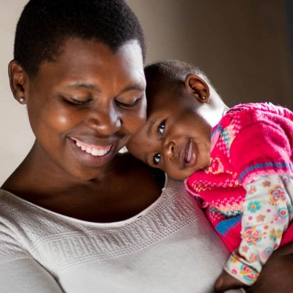
Innovative + sustainable financing
Performance enhancement for quality
Investment in frontline workforce capacities
Notes:
Financial sustainability – Cooperatives alone operating as they are cannot absorb the entire costs of the CHP unless they rapidly expand or increase their capacities of generating income. Continue investing in cooperatives and to strengthen such mechanism. The focus on cooperatives should shift from that of creating a financial sustainability mechanism to a broader one of also creating an institutional framework under which CHWs can engage in an organic and formal dialogue with the MoH regarding service provision; duties; rights.
CBHI: revising premiums for ubudehe category 2 and 3, alternative financing mechanisms such as the proposed tariffs on airtime, use of technology to automate claims; Basket fund: consideration should be made in setting up a health financing basket fund with funds ring-fenced for CHW program which has proved a success in funding Primary Health Care in Nigeria; Innovative financing mechanisms: Impact bonds (Social and/or Development impact bonds) could be explored in the longer term as a source financing for the CHW program.
Improve supervision capacities; define roles and career paths for supervisors, evaluate performance of superviosrs, innovative modalities for supervision including peer to peer
Human capital development (to address attrition rates & aging population of CHWs) develop policy directions on distribution of CHWs based on population density, geography and/or disease patterns, CHW legal framework and policy on accreditation

Slide 20
What must we do differently?
Notes:
Progress has indeed been observed, however outstanding issues still remain…

Slide 21
Systems approach to designing & strengthening community platforms for…
…supported by coordinated resource mobilization for sustainable financing of community health
…Integrated quality service delivery through effective community empowerment & engagement
Notes:
In order to leverage these global initiatives to address the system/implementation bottlenecks it calls for a shift in our thinking and approach to programming whereby we need to

Slide 22
‘…The key was an approach that put individuals and communities at the centre of care…’
H.E. P. Kagame
Child / Family-centered
Life course approach
Notes:
We need to apply approaches that
Focus on the child to address her/his the multiple overlapping deprivations
Adopt the life course approach from conception to adolescence, factoring in the differences in the challenges and needs that boys and girls face especially in adolescence

Slide 23
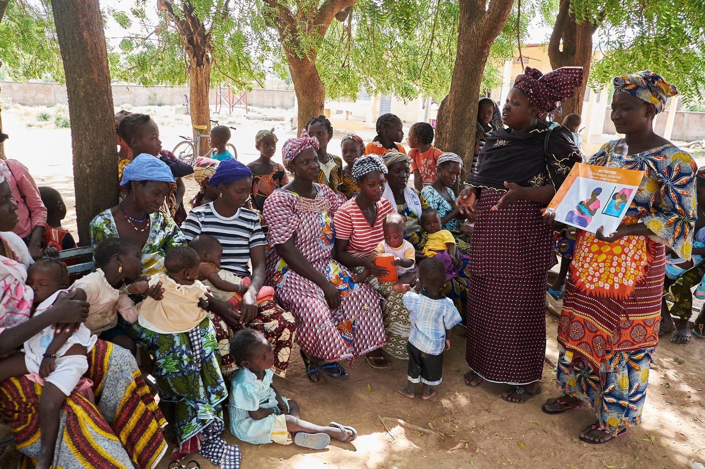
Empower communities to own and lead
Bottom-up mutual accountability
Notes:
Empower communities to own and lead; and in particular recognizes the crucial role children play in behavioural change efforts, delivery of some interventions and accountability
Support a bottom up mutual accountability mechanism, that enables communities to measure to what extent children in their community have their rights fulfilled and needs met

Slide 24
Community based certification system
Synergies and complementarities across sectors
Notes:
Establish a community-based certification system that functions both as a ‘pull’ system (due to demand creation) and a ‘push’ system (for vulnerable communities)
Foster multi-sectoral convergence (synergies and complementarities across sectors) of geographies, systems and operations for efficiency and cost-effectiveness

Slide 25
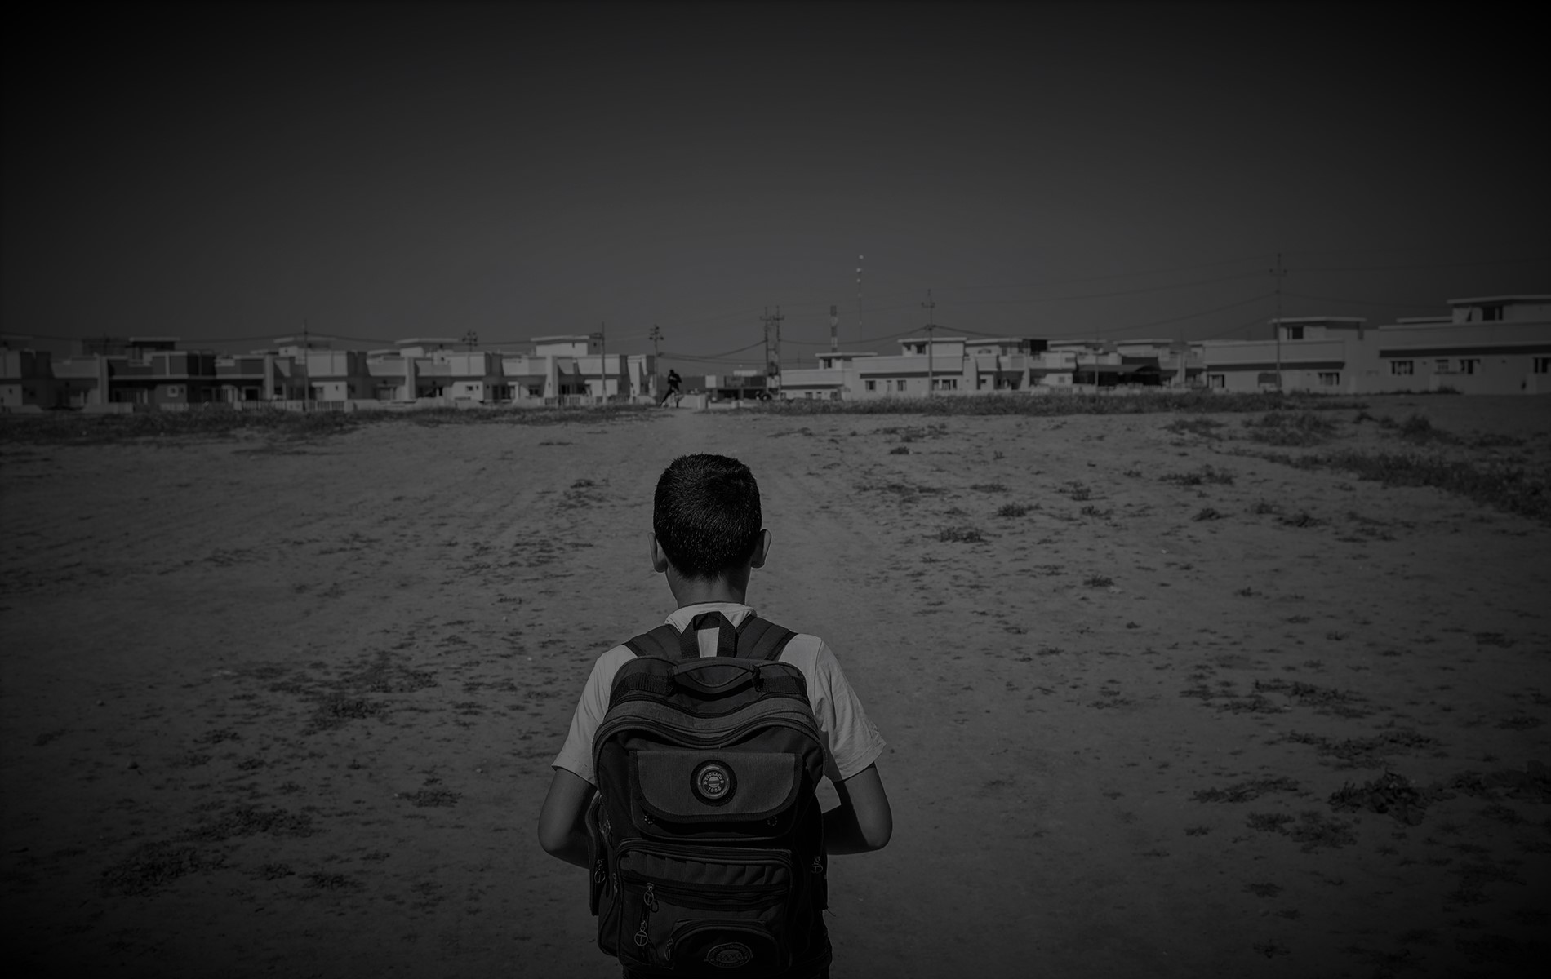
“…Each country must explore its own tailor-made solutions to strengthen its health systems. In doing so, priority must be given to prevention…”
Her Excellency Maria Fernanda Espinosa Garces, President of the 73rd session of the UNGA
Notes:
There is no one size fits all approach to meeting the UHC goal, each country must explore its own tailor-made solutions to strengthen its health systems. In doing so priority must be given to preventing disease and promoting health, as well as to ensuring access to medicines, vaccines, diagnosis and other health technologies.
The two must go in tandem.

Slide 26
Thank You

